Slide 1
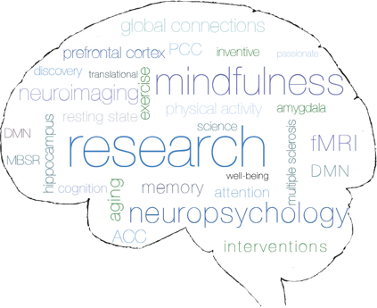
Behavior and Activity Monitoring in Multiple Sclerosis
Clinical Neuroscience Laboratory

Slide 2
Everyday Behavior and Cognition
Cognitive Function
Sleep
Water-intake
Physical activity
Social support
Nutrition

Slide 3
Are you…
Between the ages of 30 and 59?
Diagnosed with Relapsing-Remitting Multiple Sclerosis?
Free of neurological disorders other than Multiple Sclerosis?
Relapse free for the last 30 days?
Not currently using tracking devices for health behavior monitoring?

Slide 4
Would you like to…
Help expand what is known about thinking, behavior and activity monitoring, and quality of life in MS?
Possibly improve your thinking?
Receive an activity monitor like a Fitbit OR water-intake monitor?
Receive materials geared towards improving your practice of daily health behaviors?

Slide 5
What does Participation Include?
Pre-Intervention
Phone/Online
Screening
Assessment 1
1 Week Behavior monitoring
Assessment 2
6 month-Intervention
Daily Behavior monitoring
Assessment 3 (3 months into intervention)
Daily Behavior monitoring
Post-Intervention
Assessment 4
1 Week Behavior monitoring
Assessment 5

Slide 6
Participation Includes:
2 sessions (approximately 2.5 to 3 hours each) BEFORE the intervention begins and a 7-day behavior monitoring period
A 6-month behavior monitoring intervention (You will take 5 minutes a day to monitor a health behavior)
2 sessions (approximately 3 hours each) AFTER the intervention ends and a final 7-day behavior monitoring period
One session (3 months into the intervention)
Parking will be covered and you will be compensated for your time.
You will also receive a device to track your daily steps OR a device to track your daily water intake.

Slide 7
What happens during an assessment?
Assessments
Questionnaires
fMRI scan
Cardiovascular fitness test
Each assessment will be a combination of three different elements

Slide 8
Help Us with Cutting-Edge Research
Contact Us!
Email: ra@clinicalneurosciencelab.com
Call: (614) 292-9568
Visit: http://bit.ly/CNLongoing

